Slide 1
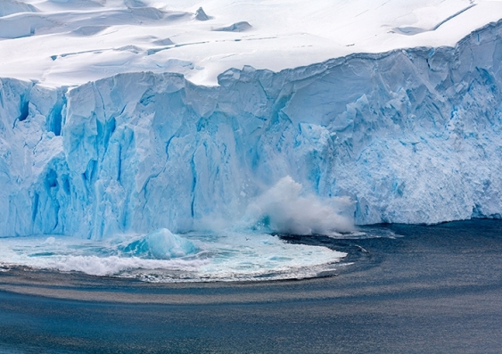
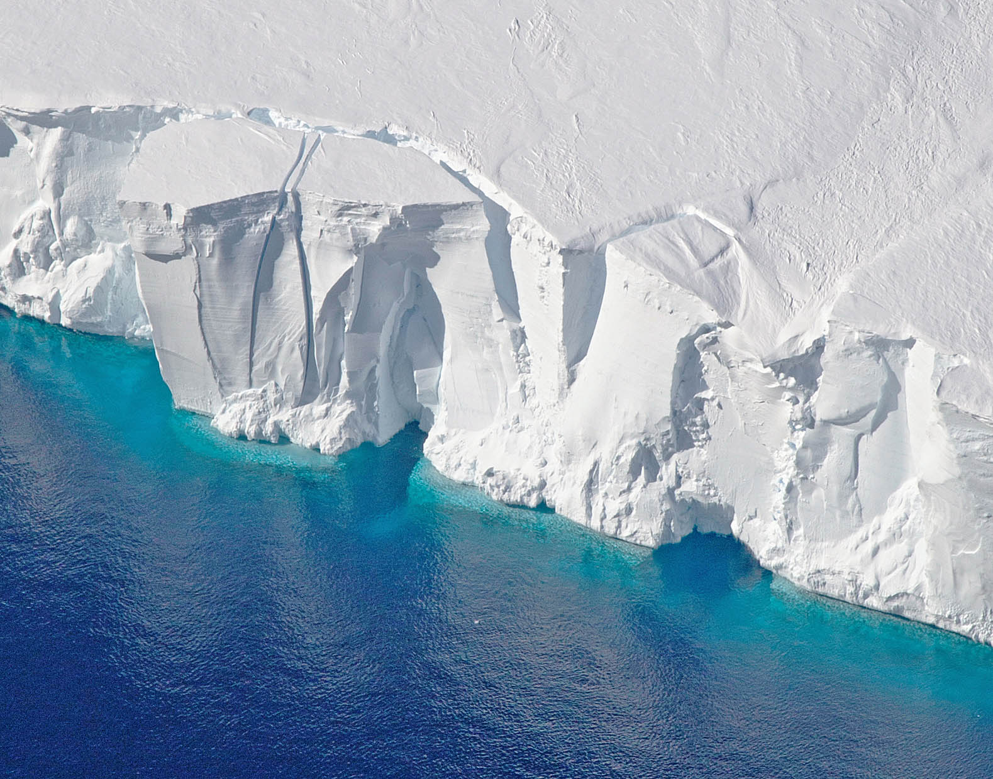
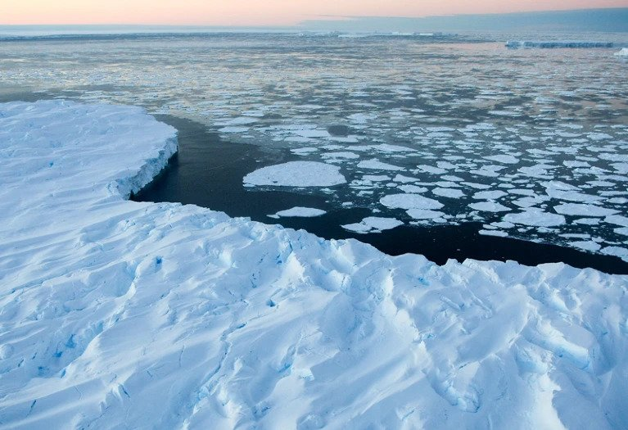
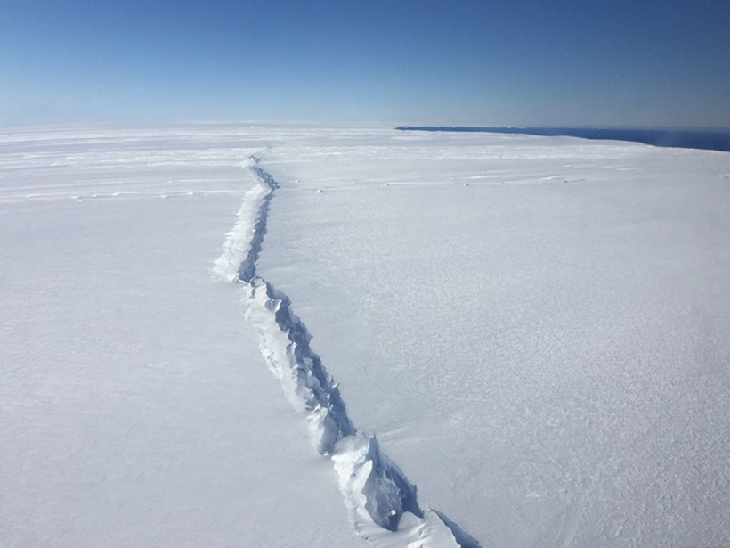
Multi-fidelity experimental design for ice-sheet models
Pierre Thodoroff

Slide 2
AGENDA
Ice-sheet models
Theoretical insights
Future directions/projects
Multi-fidelity experimental design
Applications to PDE and ice-sheet

Slide 3
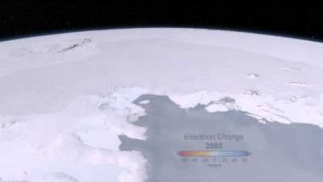
WHAT ARE Ice-sheet models?
Notes:
This is the sea we are working on.

Slide 4
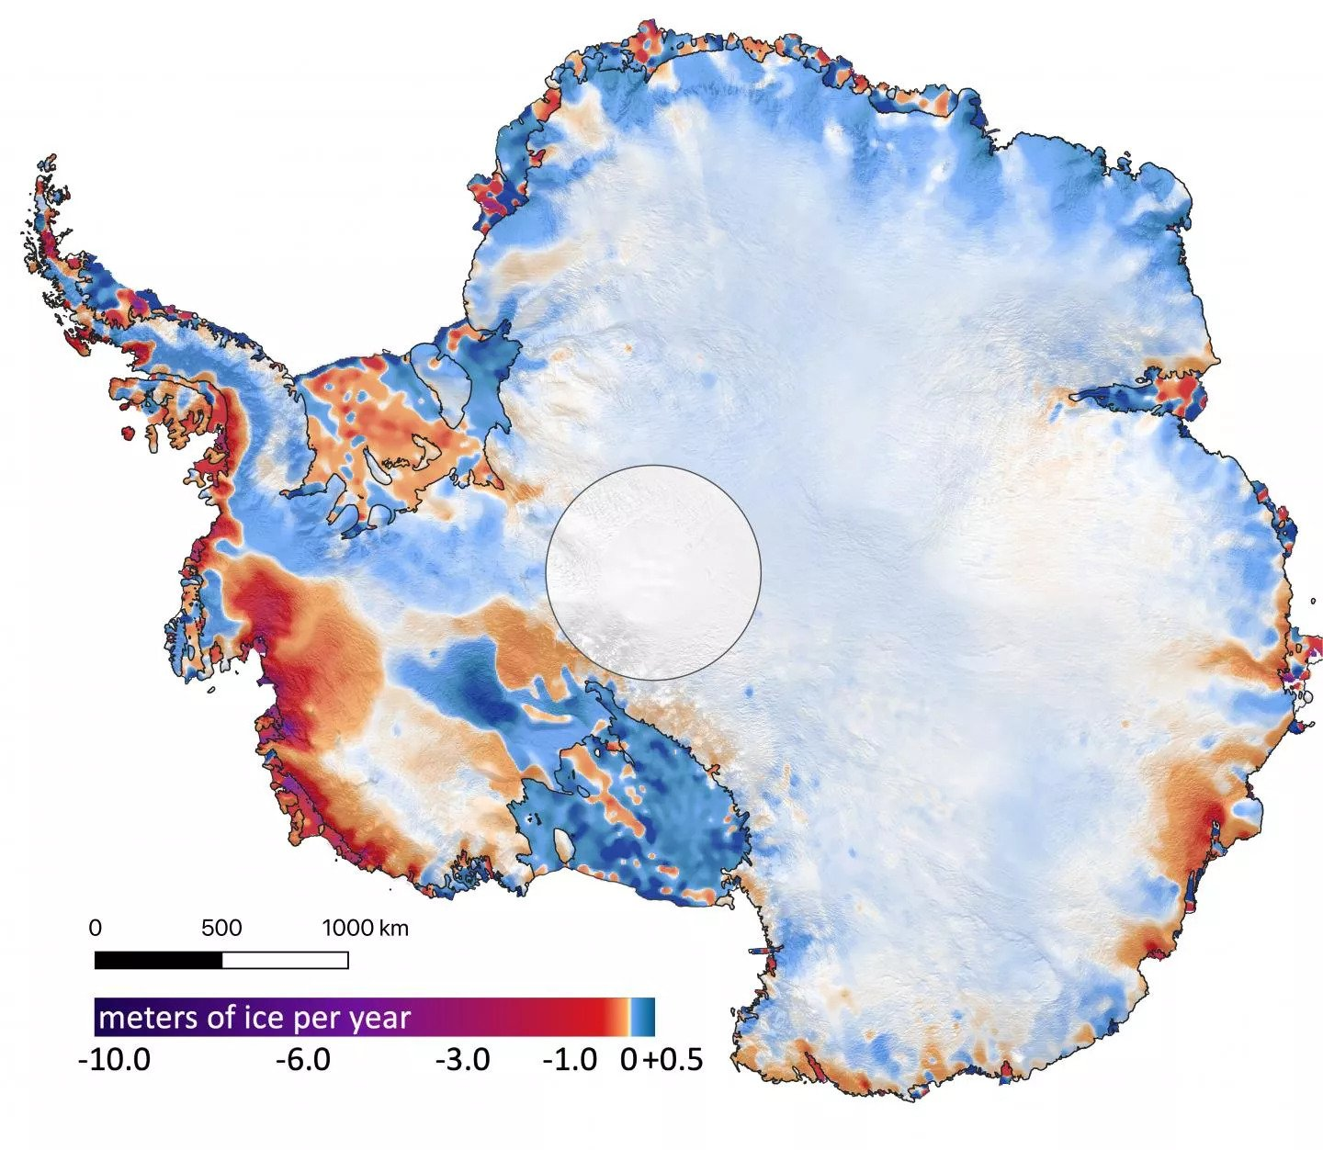
WHY ARE THEY USEFUL?
Ice reflects the sun. Used to infer impact on climate.
Predicting the melting of the ice-sheet and the contribution to the sea level. [main goal]
Ice-sheet are not stationary ice-cubes. They move and deform through time.
Intro: How thick it is? How much melts every year ? Give some quantifiable aspects. Gives perspective
How many meters (SLC) of ice is contained in antarctica. (unlikely to happen for now)?
Unknown bedrock (km of ice)
Imagine distance between west cam and (Nkm) thickness.
Bit of ice on the ground (ice-sheet). Bit over the water floating ice?
2022
4

Slide 5
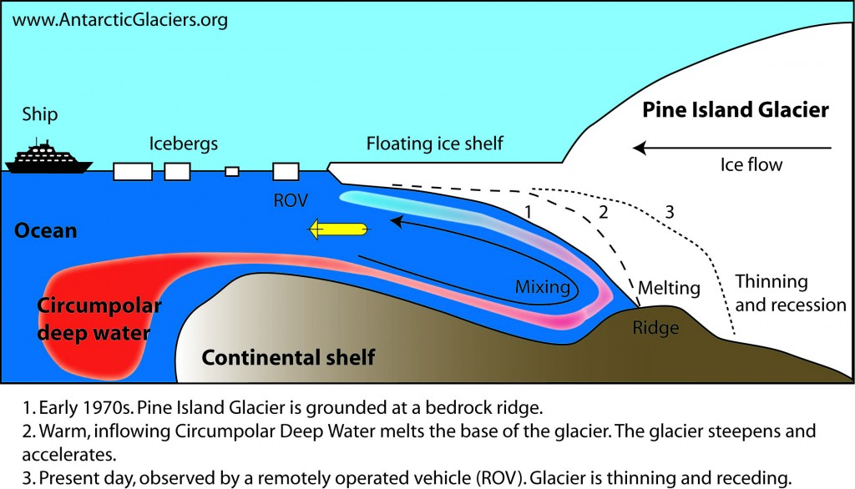
Melting of ICE

Slide 6
Modelling ice-sheets movement
Goal: predict the velocities at any spatial location in the future.
Goal 2: shape of the ice sheet changing.
Coupled mass change and velocity change. Loss and addition of mass.
model as a fluid moving through time subject to external forces (basal drag, snowfall, gravity…).
Technically: Stokes flow (PDE)

Slide 7
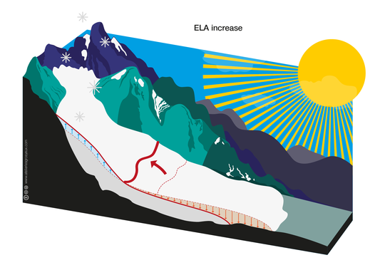
Ice-sheet 101: MASS BALANCE
Accumulation of snow
Melting
Not an external force
Separate things between mass and forces.
Separate slide about balance of momentum
Slide about mass balance

Slide 8
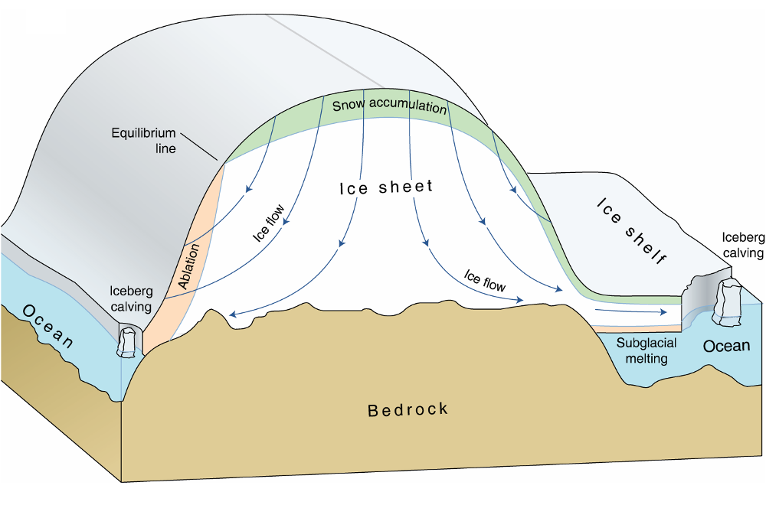
Ice-sheet 101: motion
Movements follow stokes equation
Incorporate accumulation
Bedrock (basal drag)

Slide 9
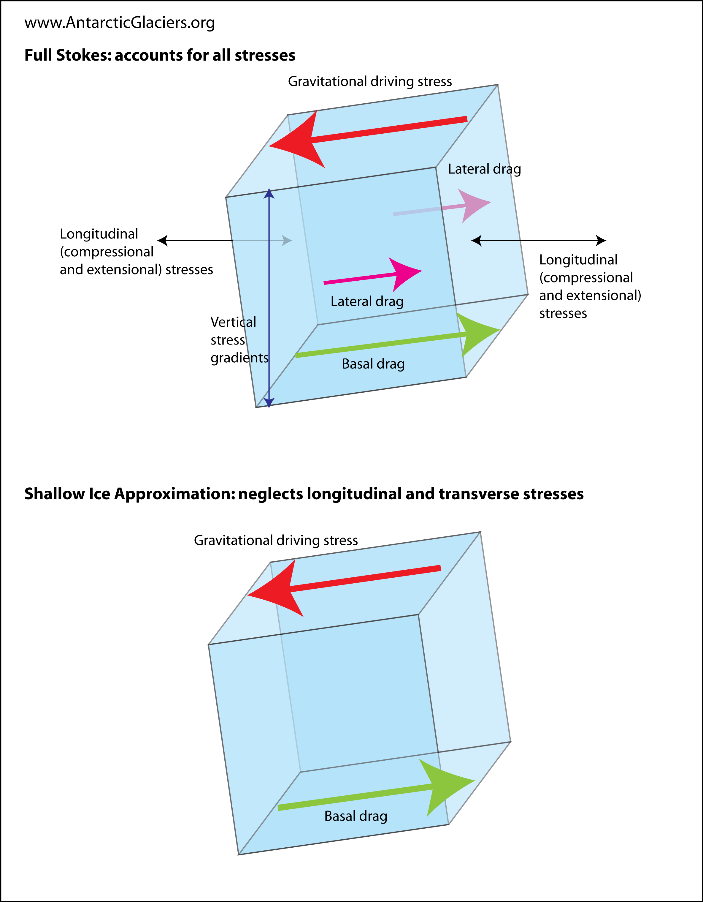
Ice-sheet 101: full stokes

Slide 10
GoaL: predict Sea level increase
Run ice-sheet for 100 years and predict the contribution to sea level?
High uncertainty over many parameters: bedrock, precipitation, future temperature..
Run the models over various input parameters.
Probabilistic estimate of increase in sea level.

Slide 11
Computational constraints
Unknown basal drags (bed rock), constraints and various forces make simulation hard and expensive (inverse problem).
Running high resolution models (small grids) can take several weeks.
Run the models over various initial states and parameter.

Slide 12
Computational optimization
Numerical solvers relies on temporal discretization to solve differential equations (no closed form solution)
Computational costs is dependant on the resolution used.
How small should my grid be to properly estimate the contribution to sea level?
Talk: optimize the utility/cost ratio of running the simulator

Slide 13
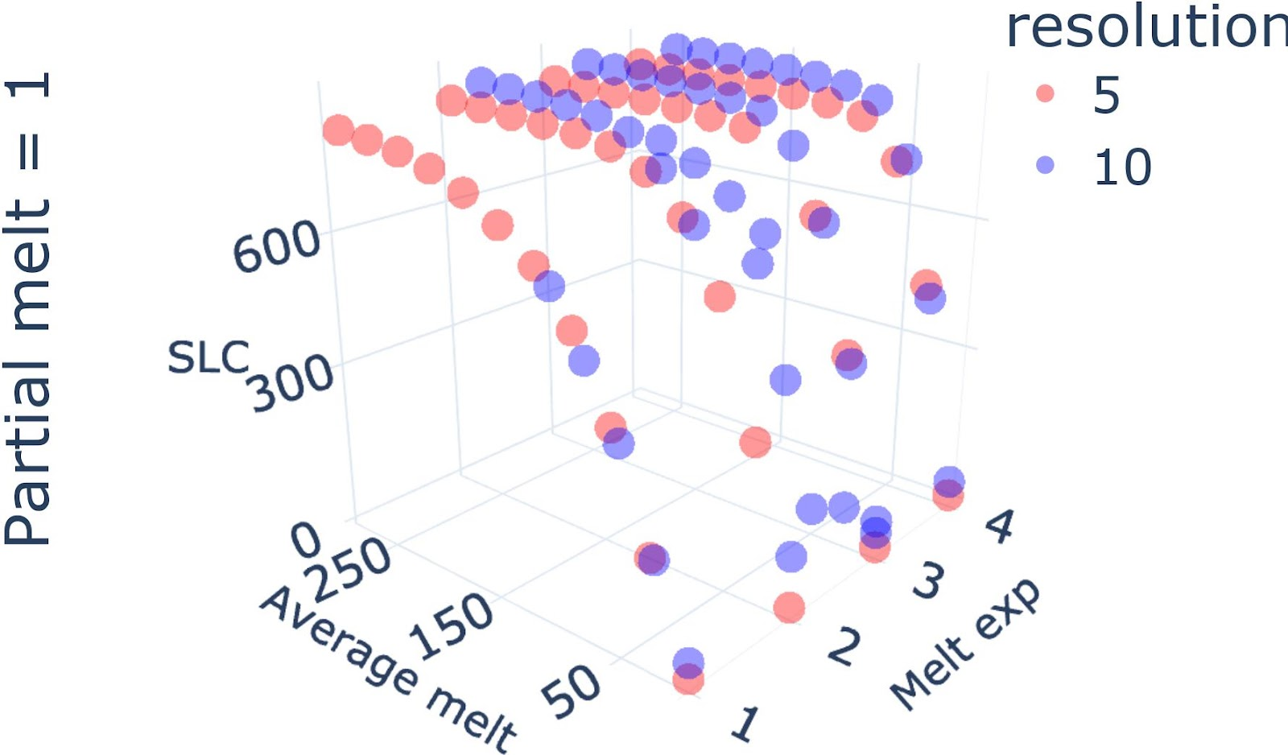
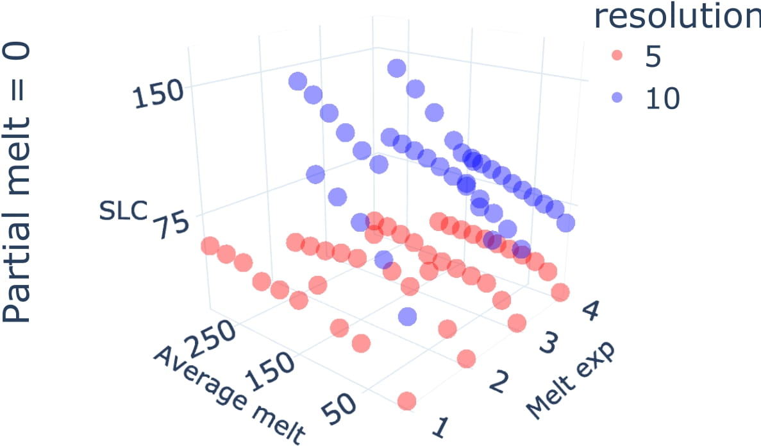
Resolution optimization: Ice-sheet

Slide 14
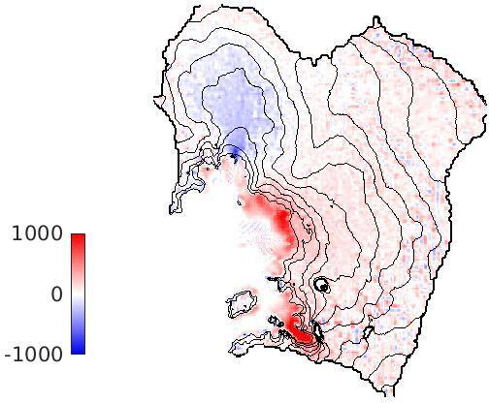
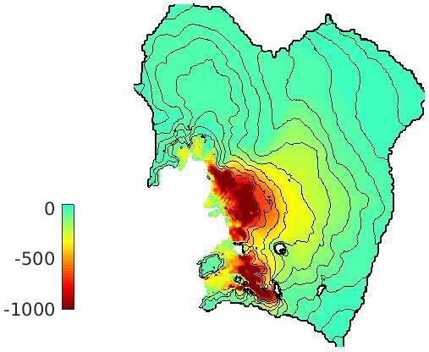
RESOLUTION DEPENDENCY
Left: modelled ice thickness change (in metres) over 100 years. Right: the difference in modelled ice thickness between a 10 km and a 3 km simulation.

Slide 15
ML agenda
Present ED MF ML
Theoretical insights
Experiments

Slide 16
TOY EXPERIMENT
Problem: learn SLC when varying temperature [0,10] atmosphere. Resolution 5 or 10k
Option A: 1 sample at 5km resolution (5 degree)
Option B: 2 samples at 10km resolution (3 and 7 degree)
Depends on the accuracy of the low resolution. but there is a threshold where you would choose one over the other (need to hide this one)

Slide 17
Multi-fidelity experimental design
Combine
Experimental design: point selection
Multi-fidelity: leverage lower cost approximations
Choose points to reduce cost-adjusted uncertainty
Lower fidelities can be interpreted as noisy version of the high fidelity runs

Slide 18
Experimental design
Goal in experimental design is …
Two strategies:
Space filling design:
Add distance based metric equations

Slide 19
Model-based ED
Talk about uncertainty reduction for a point
Cast a model GP
Look at integral of variance reduction. And take argmax of that

Slide 20
Multi-fidelity along comp axis
Numerical solvers use time-discretization to solve complex systems that don’t have closed form
Accuracy is completely correlated with dt.
How sensitive is the solution to the discretization?
View lower resolution as multi-fidelity problem. How can you combine varying degrees of accuracy
to obtain output in a cost-efficient manner

Slide 21
How to assign value to a resolution ?WHAT IS THE UNDERLYING MODEL?
Add in the slide: when sampling. relying on a model to extrapolate.
Question how far can you extrapolate. Can extrapolate along parameter axis.
But what about the computational axis? If you use space-filling how do you compare runs at different resolutions? need to build a model.
Lets build a model both for parameter and computational axis.
Equivalence in prediction in either direction if lengthscale is the same.
Whole point is learning lengthscale in this case.
But can now decide between parameter or compuational focus, quite cool
Could make example of surface being similarly impacted

Slide 22
GP model?
Add a graph modelling the plane and uncertainty around it.
RBF kernel

Slide 23
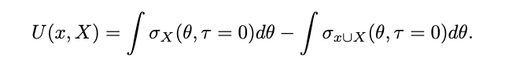
Utility of MFED
Only on the slice of highest fidelity

Slide 24
Maximize utility to choose a point?
Show graph of utility. Obvisouly best choice is to query the highest fidelity. Needs to incorporate cost
Bounded rationality
Bounded budget
Planning problem

Slide 25
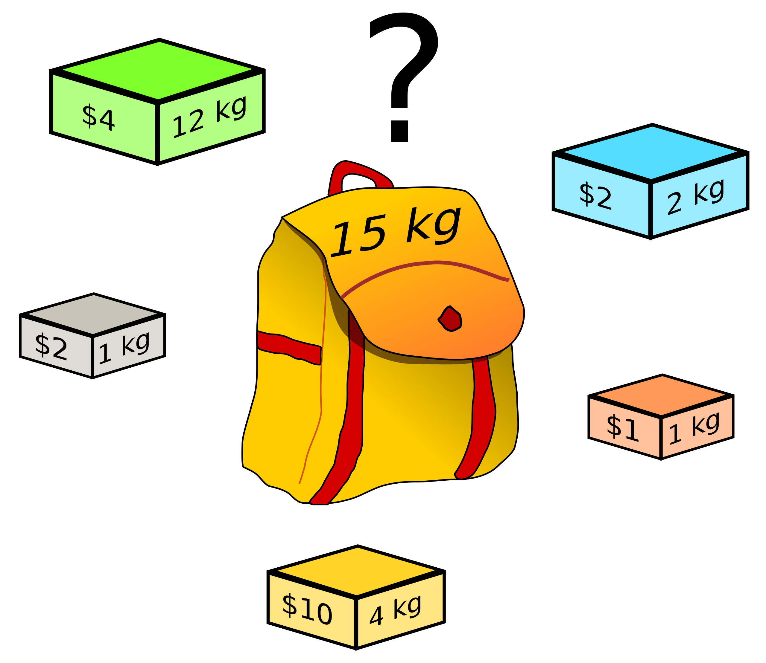
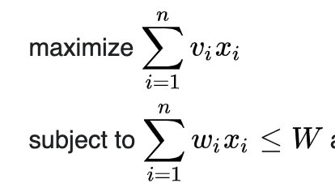
KNAPSACK PROBLEM
Combinatorial problem

Slide 26
GREEDY APPROXIMATION
Greedy approximation is good: utility/cost

Slide 27
Set maximization & Sub-modularity
What's a good strategy? Greedy. But you don't even have a knapsack lroblem' don't know the value. Points aren't independent. Submodularity makes that greedy works as well.

Slide 28
Weighted utility MFED
Greedy approximation is good: utility/cost
Display graph showing the difference
Depends on the cost model
Now we have a way to select points

Slide 29
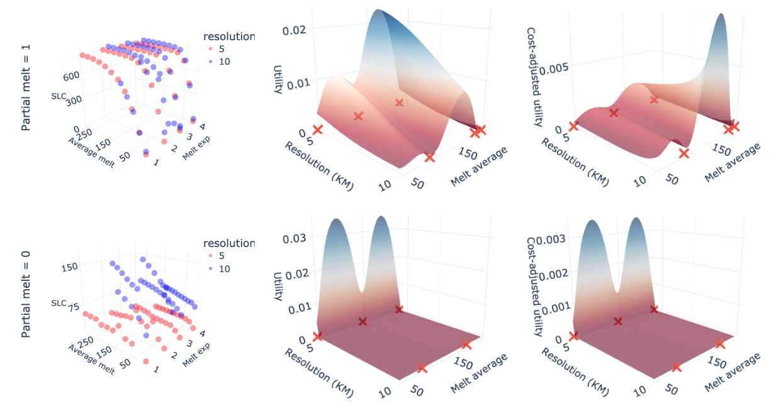
Some application on ice-sheet data

Slide 30
Analysis of how well it performs
Cast as a set maximization problem.
Compare greedy strategy with optimal
Could be one slide with slowly appearing stuff

Slide 31
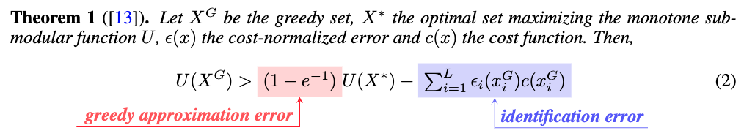
Regret of stochastic greedy strategy

Slide 32
Experiments
PDE IN GENERAL
NOTEBOOK

Slide 34
A few directions
Apply this to interesting applications
Myopic behavior is bad? Talk about myopic formulation?
Greedy behavior is bad? Talk bandit formulation. HMC. Adding exploration bonus.
More interesting modelling choices (non-stationary kernel? And its implications)?
Resolution quality trade-off is everywhere. Make computation related problem data driven !
Comparison with other strategies/baselines?

Slide 35
Interesting applications
Can work on any large scale simulator.
Resolution quality trade-off is everywhere. Make computation related problem data driven !
Basically mention my thesis

Slide 36
Myopic behavior
Add picture.
Samples one in a row. Weird behavior
Need planning

Slide 37
Optimism in the face of uncertainty
When selecting a sample we don’t assume we learn anything new about lengthscale
Estimate gets better through time and that has value
Can add exploration bonus, or use probabilistic modelling UCB style

Slide 38
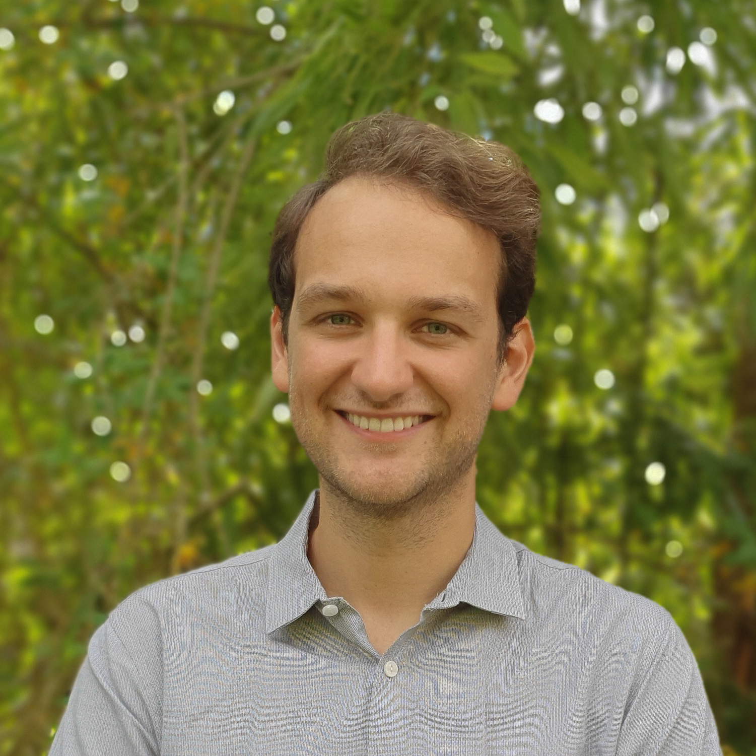
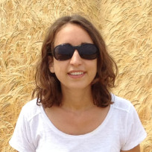
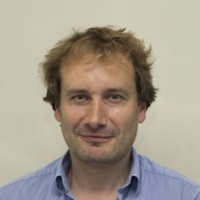
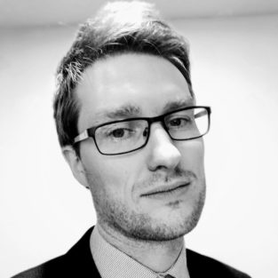
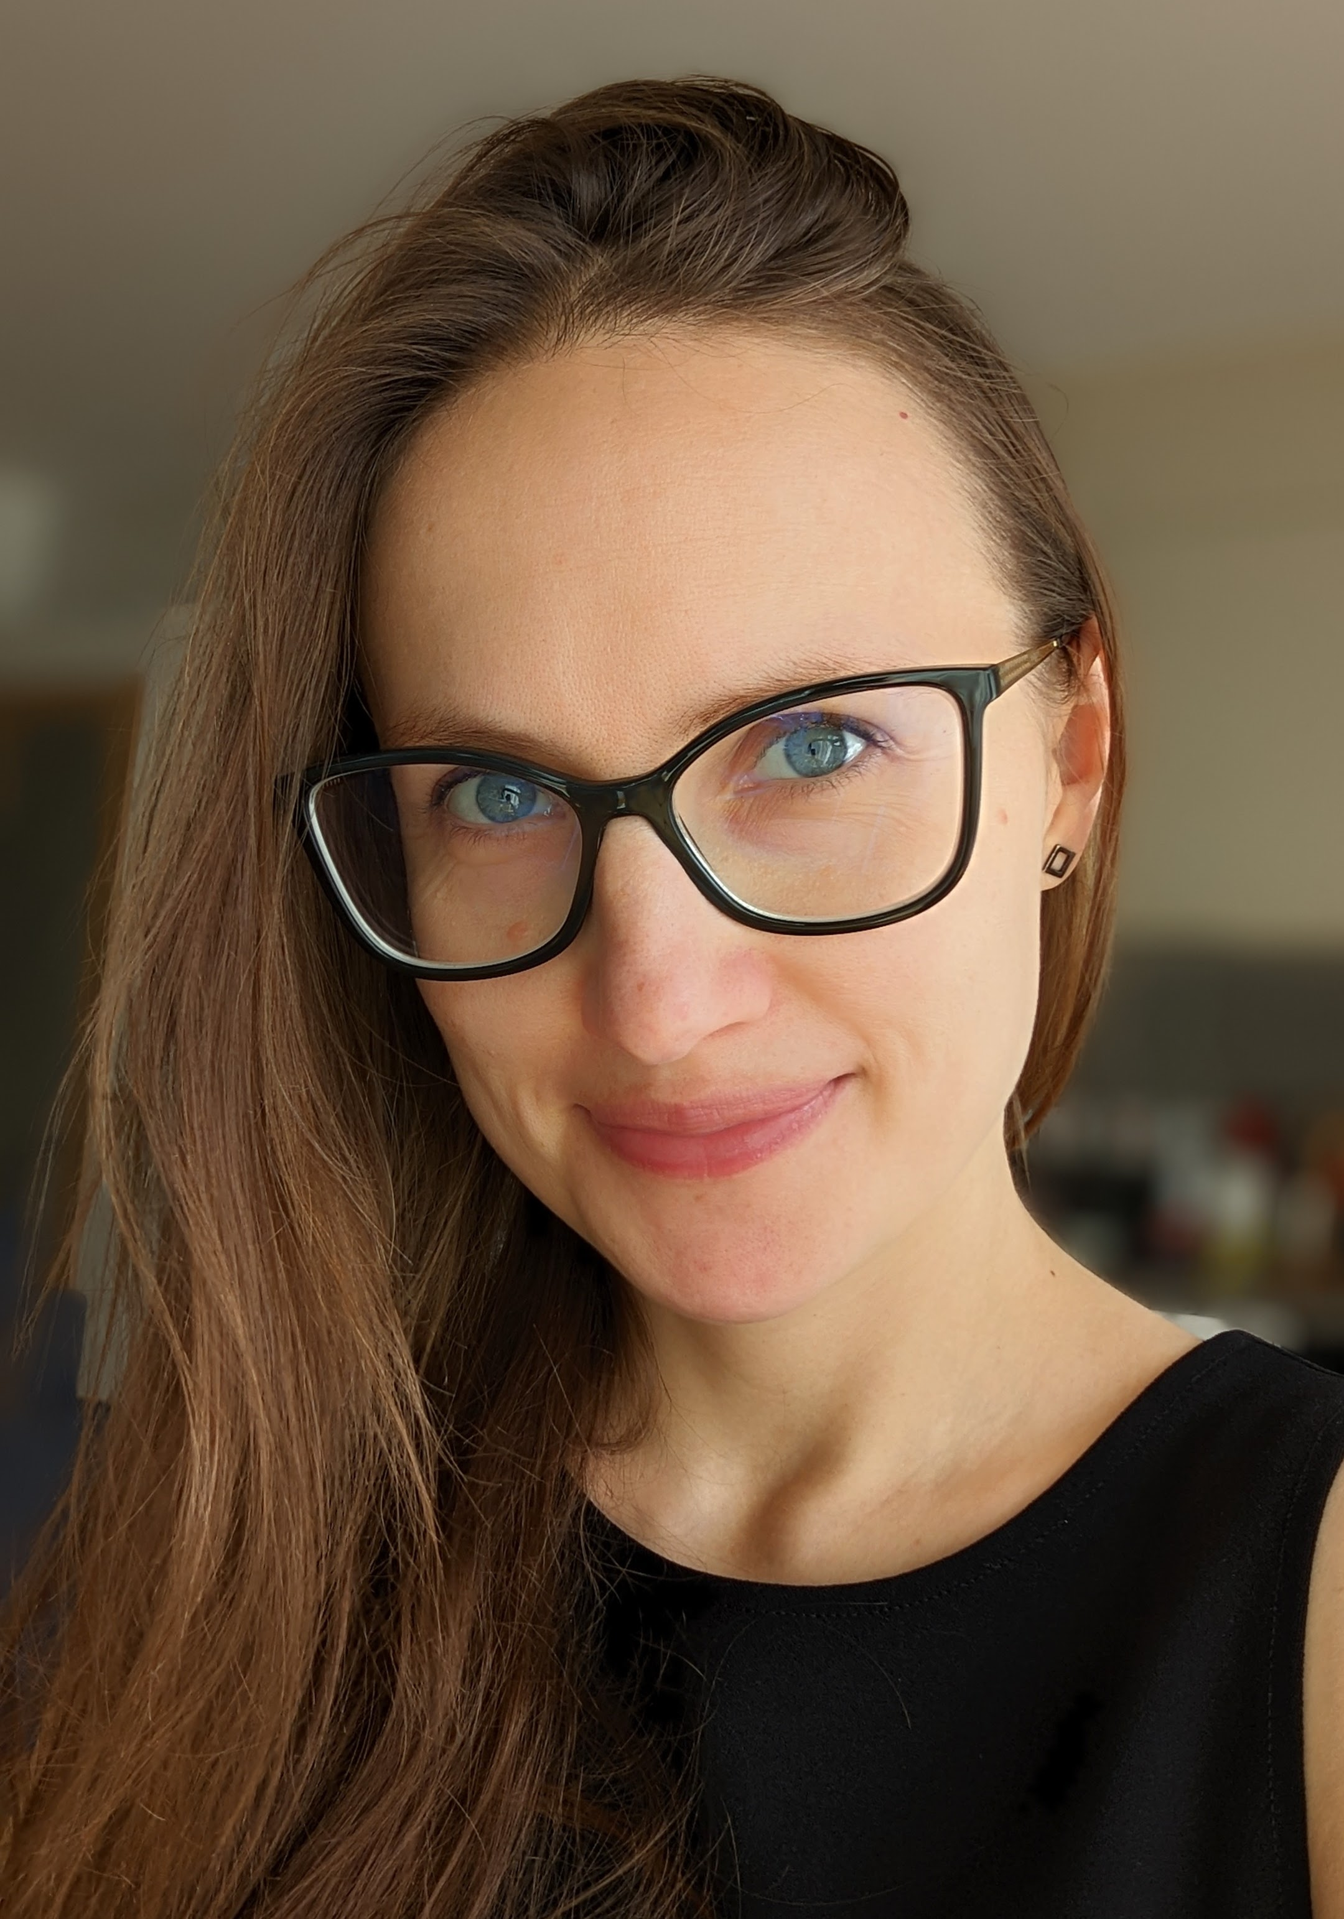
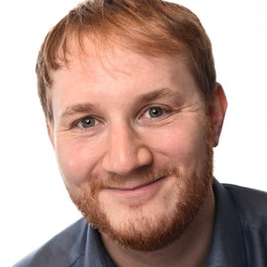
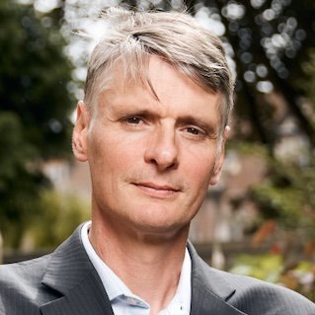
OUR TEAM
Pierre Thodoroff
Rosie Williams
Robert Arthern
Scott Hosking
Computer Lab at the University of Cambridge
British Antarctic Survey
British Antarctic Survey
British Antarctic Survey
Ieva Kazlauskaite
Marcus Kaiser
Neil Lawrence
Department of Engineering at the University of Cambridge
Computer Lab at the University of Cambridge
Computer Lab at the University of Cambridge

Slide 39
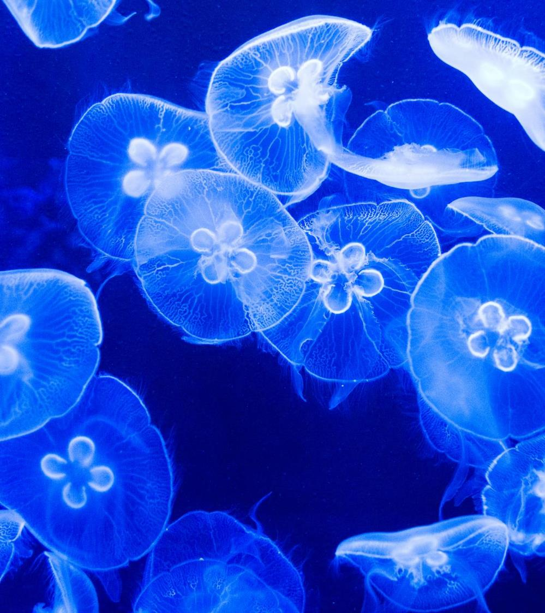
THANK YOU Reference
Pierre Thodoroff

Slide 40

Reference
RICHARD BRANSON

Slide 41
References

Slide 42

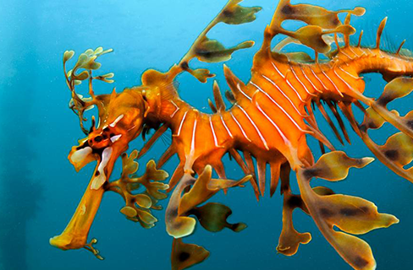
INTRODUCTION
At Contoso, we empower organisations to foster collaborative thinking to further drive workplace innovation. By closing the loop and leveraging agile frameworks, we help business grow organically and foster a consumer-first mindset.

Slide 43
Business opportunities are like buses. There's always another one coming.
RICHARD BRANSON

Slide 44

PRIMARY GROWTH
Areas of focus

Slide 45
QUARTERLY PERFORMANCE

Slide 46
Areas of growth
 | B2B | SUPPLY CHAIN | ROI | E-COMMERCE
Q1 | 4.5 | 2.3 | 1.7 | 5.0
Q2 | 3.2 | 5.1 | 4.4 | 3.0
Q3 | 2.1 | 1.7 | 2.5 | 2.8
Q4 | 4.5 | 2.2 | 1.7 | 7.0

Slide 47

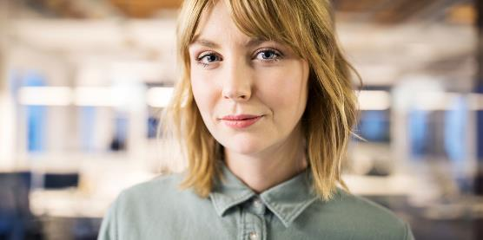


OUR TEAM
TAKUMA HAYASHI
MIRJAM NILSSON
President
Chief Executive Officer
FLORA BERGGREN
RAJESH SANTOSHI
Chief Operations Officer
VP Marketing

Slide 49
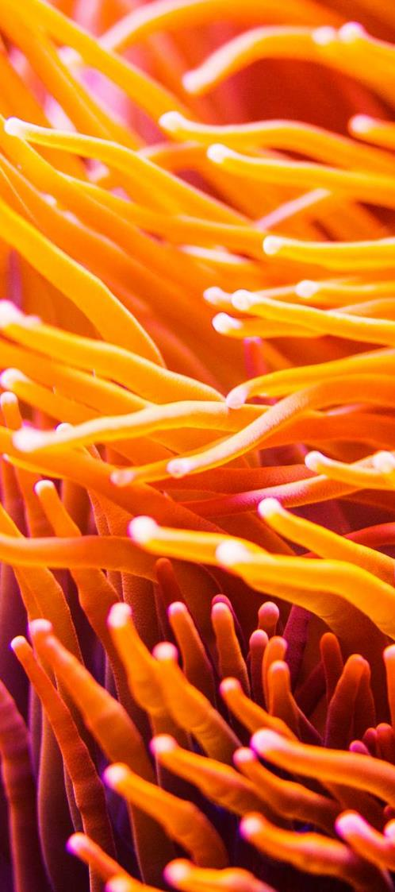
AREAS OF FOCUS
B2B MARKET SCENARIOS
CLOUD BASED OPPORTUNITIES
Develop winning strategies to keep ahead of the competition
Capitalize on low hanging fruit to identify a ballpark value
Visualise customer directed convergence
Iterative approaches to corporate strategy
Establish a management framework from the inside

Slide 51
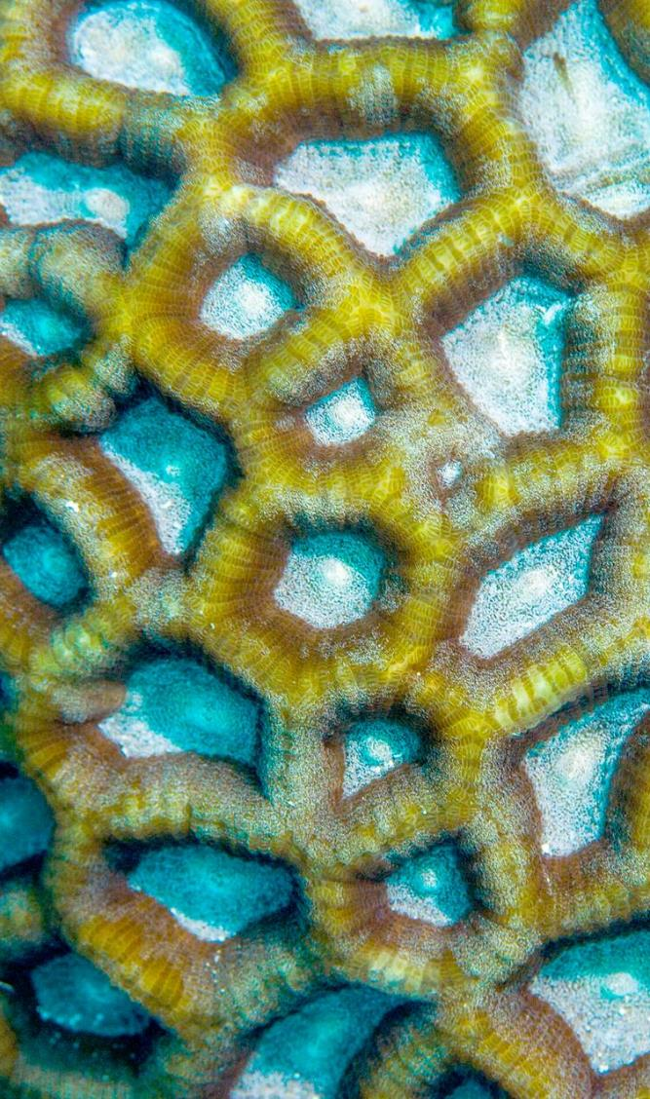
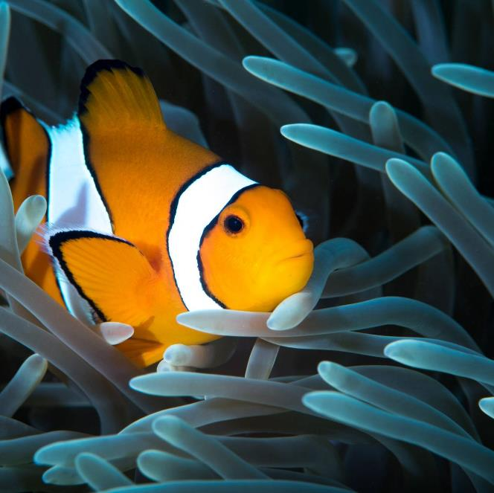
SUMMARY
At Contoso, we believe in giving 110%. By using our next-generation data architecture, we help organisations virtually manage agile workflows. We thrive because of our market knowledge and great team behind our product. As our CEO says, "Efficiencies will come from proactively transforming how we do business."

